Slide 1
The agile flows defined by openflow
Author: YANG XURONG, DONG WENYING, XIONGZHAOZHONG

Slide 2

Contents
Design
System architecture
Data models
Work flows
Flow table
Part1
Part2
Problem & Background
Testing & Demo
Testing
Demo
Our work
Part3

Slide 3
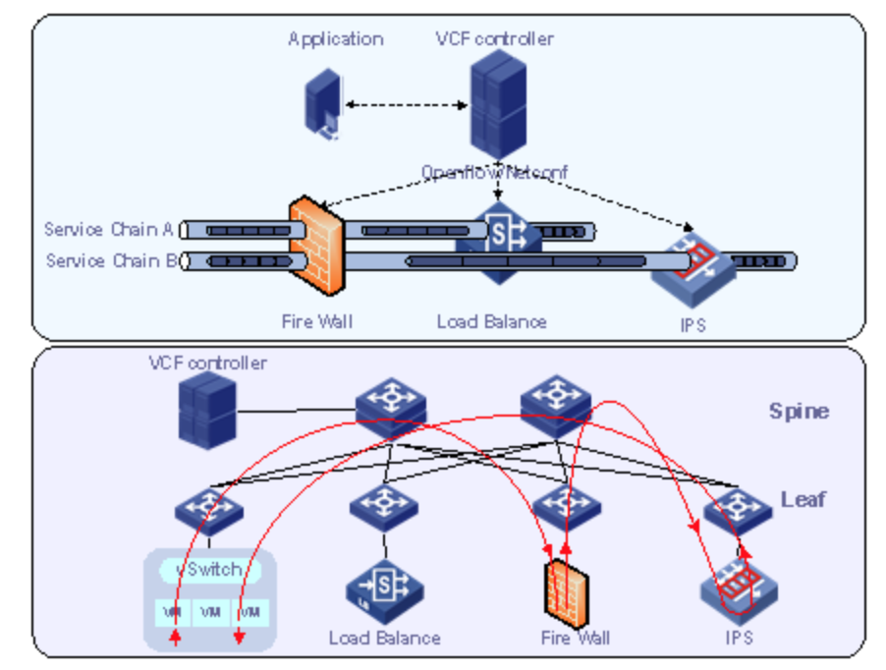
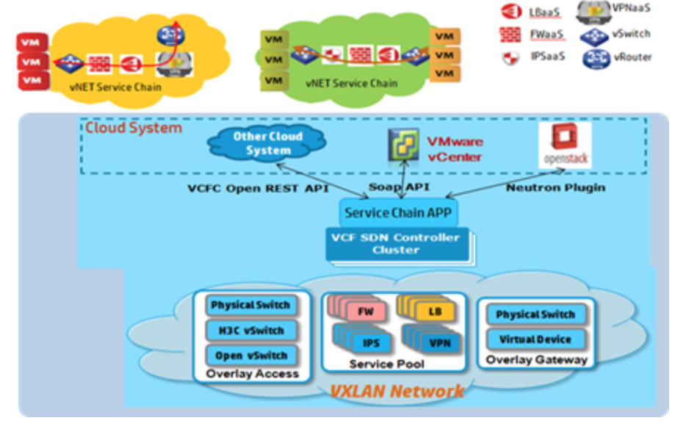
Problem & Background
By using various network resource pool, user can define different network service chaining to support agile application service

Slide 4


System Architecture
UI / CLI
application
Controller
src | dst | service | Agile flows
HOSTA | HOSTB | Application 1 | FW
HOSTA | HOSTB | Application2 | NAT
HOSTB | HOSTC | Application1 | FW->DPI->WAF
HOSTC | HOSTB | Application1 | FW->DPI->WAF
DPI
Service Chain
NAT
VS0
LB
FW
Define various ordered network
service chain, and implemented by openflow rules
HostA
HostB
HostC

Slide 5
Data Models
Node table Host/vs/nf | Node_id(uuid) | Name(string) | Type(string) | Mac_list(list)
 | 12dfdefsdaf | vs0 | vswitch | [1a:ef:e4:23:58,…]
Link table | Link_id(uuid) | Src_node_id | Dst_node_id | ofport | outport
 | fed123321 | 12dfdefsdaf | 12dfdefsdad | 1 | 2
Service chain template table | Template_id(uuid) | Name(string) | Pipe(string)
 | 3dfd234445 | Sc_template1 | FW->NAT->DPI->WAF
User service chain instance | Sc_id(uuid) | Sc_name(string) | Template_id(uuid) | Proto(string) | Application_port(id)
 | 234567890 | sc1 | 3dfd234445 | tcp | 80
Binding table Bind host to service chain | Node_id(uuid) | Sc_id(uuid) | Binding_id(uuid)
 |  | Service_chian_id | Bind host to specific service chain instance

Slide 6
Work flows
HOST
VS0
FW
NAT
LB
Src_mac: from host?
ofport：from where?
port: has defined agile flow?
outport: ?
Src_mac: from host?
ofport：from where?
port: has defined agile flow?
outport: ?

Slide 7
Flow table
FOR CORE vswitch
We use application port and ofport to decide where need to go for next station. Othersise, every packet go with normal flow.
Table=0
ofport：from where?
port: has defined agile flow?
outport:
Table=20
For FW
Table=21
For NAT
Table=21
For WAF
Table=0
Src mac: host mac?
port: has defined agile flow?
Resubmit (;20)
FOR NETWORK SERVICE
Using the src mac and application port
Table=20
Fw rule
Nomal flow

Slide 8
Testing Models
UI / CLI
NAT rules:
cookie=0x0, duration=9.105s, table=0, n_packets=0, n_bytes=0, idle_age=9, priority=2000,tcp,tp_dst=80 actions=load:0xc0a80101->NXM_OF_IP_DST[]
application
Controller
DPI
Service Chain
NAT
VS0
LB
FW
FW rules:
cookie=0x0, duration=16.287s, table=0, n_packets=0, n_bytes=0, idle_age=16, priority=2000,tcp,tp_dst=80 actions=drop
HostA
HostB
HostC
pplication Services

Slide 9









TestCase1: agile flow VS none flow
Not define agile flow
Host1 tcp connect host4 ok
But not pass any network service node
ok
step1
step2
ok
Host1 ping host4 ok but not applying agile flow
step3
step4
OK
User define agile flow for tcp application
host1 ping host4 ok but apply agile flow
ok
User delete agile flow, host1 still tcp connect host4 ok

Slide 10
TestCase1: agile flow VS none flow
FW
NAT
LB
WAF
Host1
Host4
Ping ok but not apply agile flow
Tcp connect ok
with agile flow
TCP connect ok

Slide 11
TestCase2: Fwaas agile flow
ok
Host1 Host4 tcp connection
step1
step2
OK
User define FW agile flow
step3
step4
ok
Add fw rule and fwaas work, drop matched application service
ok
FW
Delete fw rule, then connection success
Host1
Host4

Slide 12




Our work
Django
Dashboard
Application
mininet
topo
python
CLI

Slide 13
Thank You !

